Slide 1
Pricing Forecast Capability Assessment
of Linear Regression, ARIMA, Random Forest and LSTM Models
Cheng Ying Yu, Ku Ho Kat, Pong Zhun Log, Wong Sai Cheong
Course: Python Data Analysis (CT298)
Submission Date: 21 October 2026

Slide 2
Agenda
2 / 14
01
Executive Summary
02
Introduction & Objectives
03
Data Analysis & Methodology
04
Model Architectures
05
Results & Performance Comparison
06
Recommendations & Conclusion
07
Q&A
CT298 · Python Data Analysis · 20 Oct 2026

Slide 3
1. Executive Summary
3 / 14
Four forecasting models evaluated on five financial assets
Random Forest
Best overall on S&P 500, 0388.HK, 0005.HK
Strong results for S&P 500 Index
Autoregressive Integrated Moving Average (ARIMA)
Outperformed on 0386.HK (nonlinear patterns)
Long Short-Term Memory (LSTM)
Linear Regression
Most accurate forecasts for HSI
Key Insight: No single model dominated → Hybrid framework recommended
CT298 · Python Data Analysis · 20 Oct 2026

Slide 4
2. Introduction
4 / 14
Why Price Forecasting Matters
▸ Identify market opportunities and improve asset allocation
▸ Manage downside risks in portfolio construction
▸ Support informed investment decision-making
Challenge
Financial markets exhibit non-linearity, volatility clustering, structural breaks, and external shocks — making accurate forecasting difficult.
Models Compared
Linear Regression
Autoregressive Integrated Moving Average (ARIMA)
Random Forest
Long Short-Term Memory (LSTM)
Statistical baseline
Classical time-series
Ensemble ML
Deep learning
CT298 · Python Data Analysis · 20 Oct 2026

Slide 5
Assets Under Study
5 / 14
Five financial assets selected for evaluation
^GSPC
S&P 500 Index
US Equity Index
^HSI
Hang Seng Index
HK Equity Index
0005.HK
HSBC Holdings
Banking Equity
0386.HK
Sinopec Corp.
Energy Equity
0388.HK
HKEX
Exchange Equity
CT298 · Python Data Analysis · 20 Oct 2026

Slide 6
3. Data Analysis & Methodology
6 / 14
1
2
3
4
5
→
→
→
→
Data Collection
Cleansing
Preprocessing
Modeling
Evaluation
Yahoo Finance API
~3 years daily data
bfill + dropna +
Outlier review
Simple Moving Average
Stationarity tests
4 models with
hyperparameter tuning
RMSE · MAE · MAPE
80/20 sequential split
Key Assumptions
Limitations
• Historical patterns contain predictive signal
• Relationships persist over forecast horizon
• Prices reflect historical time-series info
• Black-swan events & regime shifts
• Macro / geopolitical shocks
• No model eliminates investment risk
CT298 · Python Data Analysis · 20 Oct 2026

Slide 7
Data Preprocessing Highlights
7 / 14
Feature Engineering
Model-Specific Prep
Moving Averages
Linear Reg.
Simple Moving Average for trend smoothing
Remove extreme 2–4% daily returns to improve R²
Volatility
ARIMA
Rolling std-dev shows clustering
Differencing + log transform for stationarity
Stationarity
Random Forest
ADF test: raw series non-stationary
Features: Bias, MA Divergence, CV, Activity, Vol Momentum
Target: Next-day return
LSTM
MinMaxScaler [0,1]; stacked LSTM + Dropout
CT298 · Python Data Analysis · 20 Oct 2026

Slide 8
4. Model Architecture & Tuning
8 / 14
Linear Regression
ARIMA
Y = β₀ + β₁X₁ + … + βₙXₙ + ε
Yₜ = c + ΣφᵢY₍ₜ₋ᵢ₎ + Σθⱼε₍ₜ₋ⱼ₎ + εₜ
• Benchmark model
• Historical predictors + lags
• Assumes linear relationship
• Optimized (p,d,q)
• Stationarity validated
• Autocorrelation focus
Random Forest
LSTM
Ŷ = (1/B) Σ Tᵦ(X)
hₜ = oₜ · tanh(Cₜ)
• n_est: 100/200, max_depth: 3/5/7,
min_sample_leaf: 20, 30
• Convert the predicted returns to predicted price
• Stacked LSTM + Dropout
• Dense output, Adam, MSE
• Chronological split
CT298 · Python Data Analysis · 20 Oct 2026

Slide 9
Evaluation Metrics
9 / 14
Lower values = better forecasting accuracy
Mean Absolute Error
MAE
Baseline magnitude of residual errors on a linear scale. Robust to outliers. Expressed in price units.
Root Mean Squared Error
RMSE
Heavily penalizes large deviations. Critical for assessing whether models mitigate tail-risk prediction errors.
Mean Absolute Percentage Error
MAPE
Scale-independent percentage error. Enables fair comparison across assets with different price levels.
CT298 · Python Data Analysis · 20 Oct 2026

Slide 10
5. Results Overview — Best Model by Asset
10 / 14
Asset
Best Model
Reason
S&P 500
Random Forest / ARIMA
Lowest RMSE, MAE & MAPE
HSI
Linear Regression
Lowest RMSE, MAE & MAPE
0386.HK
LSTM
Lowest RMSE, MAE & MAPE
0388.HK
Random Forest
Lowest RMSE, MAE & MAPE
0005.HK
Random Forest
Best accuracy across metrics
No single model dominates → asset-dependent performance
CT298 · Python Data Analysis · 20 Oct 2026

Slide 11
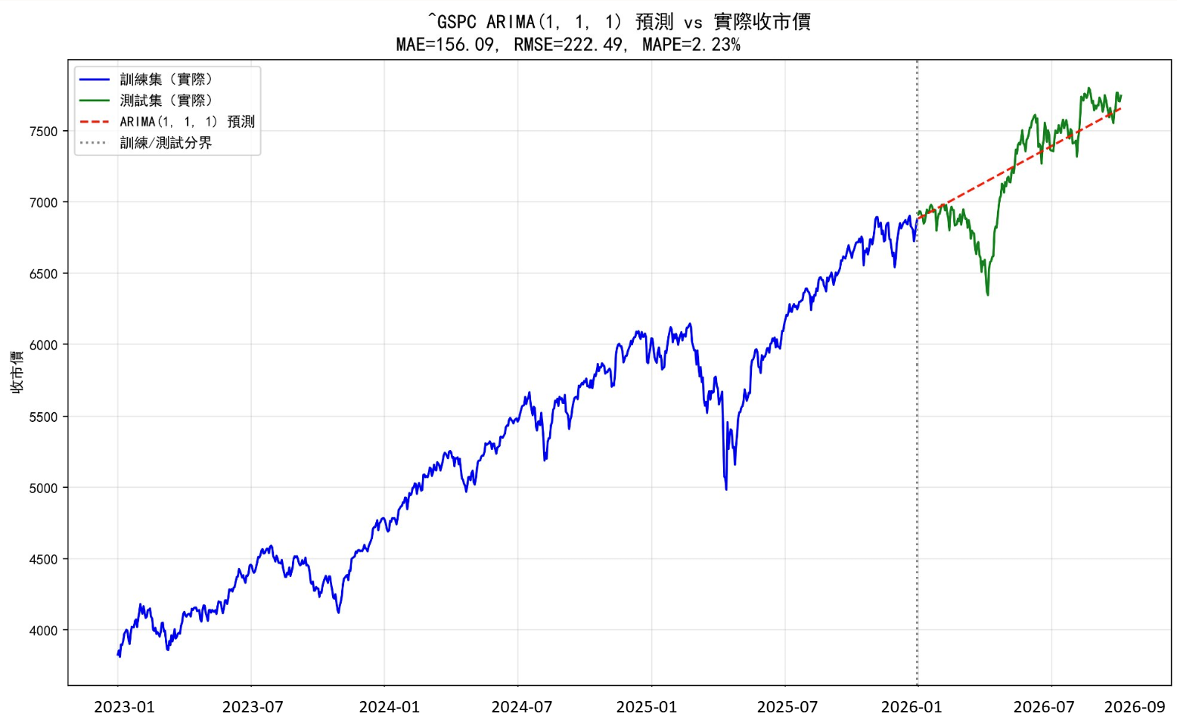
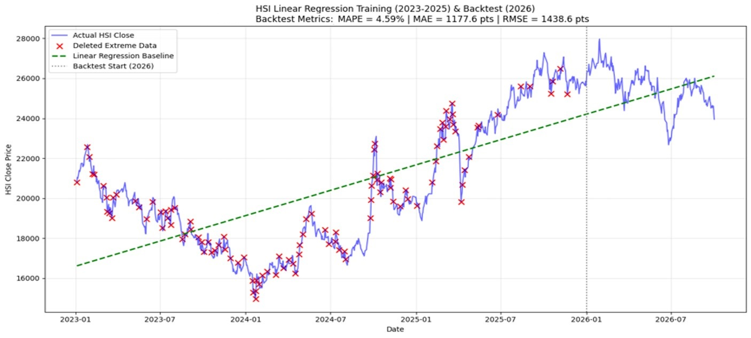
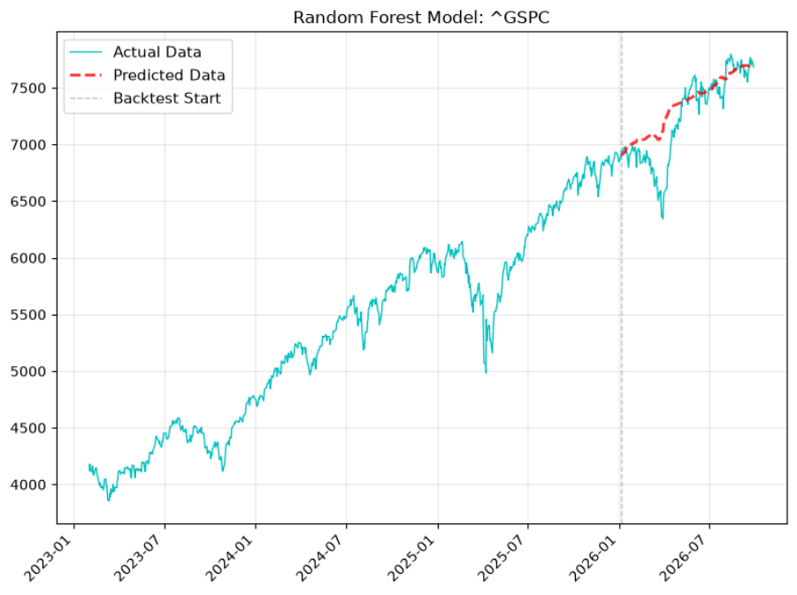
Detailed Results — S&P 500 & HSI
11 / 14
Table 1. S&P 500 Model Performance
Table 2. HSI Model Performance
Model
RMSE
MAE
MAPE
Model
RMSE
MAE
MAPE
Linear Reg.
234.14
193.00
2.68%
Linear Reg.
1,438.64
1,177.65
4.59%
LSTM
474.98
468.22
7.65%
LSTM
2,351.28
2,311.69
9.67%
Random Forest
223.58
153.29
2.21%
Random Forest
2,036.34
1,630.29
6.55%
ARIMA
222.49
156.09
2.23%
ARIMA
1,661.94
1,400.72
5.63%
ARIMA lowest RMSE; RF lowest MAE/MAPE
Linear Regression clearly best for HSI
ARMIA
Random Forest
[Insert HSI forecast chart / residual plot]
CT298 · Python Data Analysis · 20 Oct 2026

Slide 12
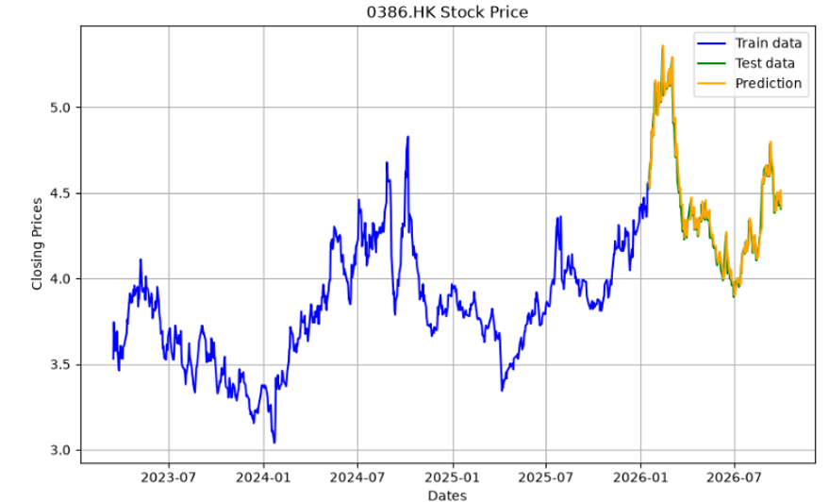
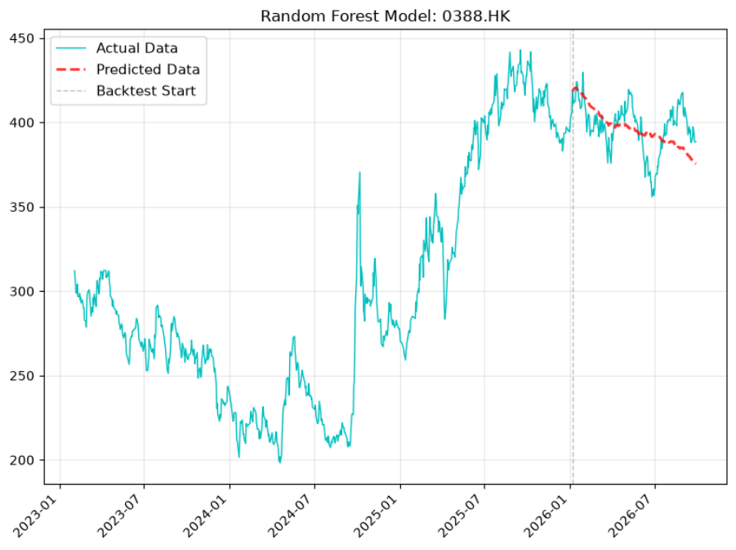
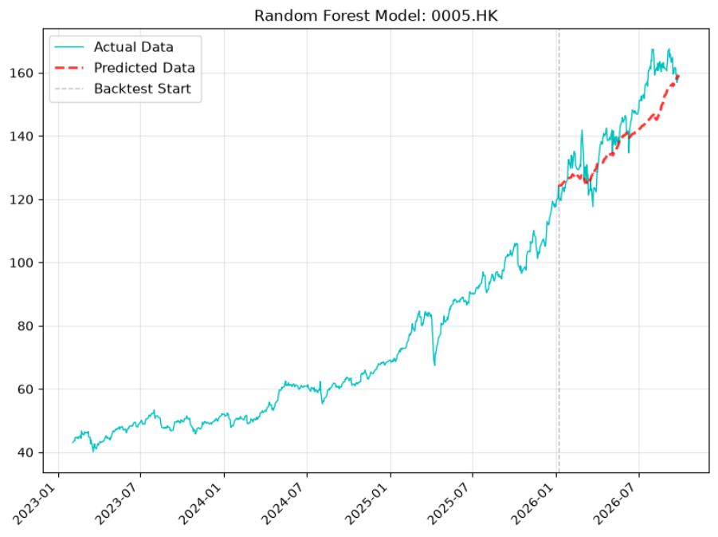
Detailed Results — Individual Equities
12 / 14
0386.HK (Sinopec)
0388.HK (HKEX)
0005.HK (HSBC)
Best: LSTM
Best: Random Forest
Best: Random Forest
Model
RMSE
MAE
MAPE
Model
RMSE
MAE
MAPE
Model
RMSE
MAE
MAPE
Linear Reg.
0.45
0.33
6.99%
Linear Reg.
21.59
17.65
4.43%
Linear Reg.
37.83
36.49
25.01%
LSTM
0.19
0.18
4.85%
LSTM
45.53
44.24
11.38%
LSTM
11.25
11.14
12.56%
Random Forest
0.58
0.51
11.77%
Random Forest
14.89
12.28
3.12%
Random Forest
8.21
6.76
4.55%
ARIMA
0.37
0.32
7.17%
ARIMA
30.66
27.26
7.01%
ARIMA
13.88
11.82
7.81%
LSTM captures nonlinear temporal deps.
Ensemble learning most effective
RF best across all metrics
CT298 · Python Data Analysis · 20 Oct 2026

Slide 13
6. Recommendations
13 / 14
1
Adopt asset-type-based model selection rather than a single methodology across all securities.
2
Use Random Forest as the default production model — best overall balance of RMSE, MAE and MAPE.
3
Retain ARIMA as benchmark / validation model for market indices (strong on S&P 500).
4
Deploy LSTM selectively for stocks with pronounced nonlinear temporal dependencies (e.g., 0386.HK).
5
Incorporate external macro indicators, sector sentiment, and implied volatility to enhance predictive breadth.
6
Tune dynamically and early-stop to prevent overfitting; build weighted portfolios and track cumulative returns.
CT298 · Python Data Analysis · 20 Oct 2026

Slide 14
7. Conclusion
14 / 14
Key Takeaways
▸ Forecasting performance is asset-dependent — no universal winner.
▸ Random Forest delivered the strongest overall capability across most assets.
▸ ARIMA remains highly competitive for index-level forecasting.
▸ LSTM excels where nonlinear temporal relationships dominate.
Recommended Approach
Hybrid framework combining ARIMA + Random Forest + LSTM
to improve accuracy, robustness across regimes, and decision quality.
Thank You · Questions Welcome
CT298 · Python Data Analysis · 20 Oct 2026

Slide 15
Appendix

Slide 16
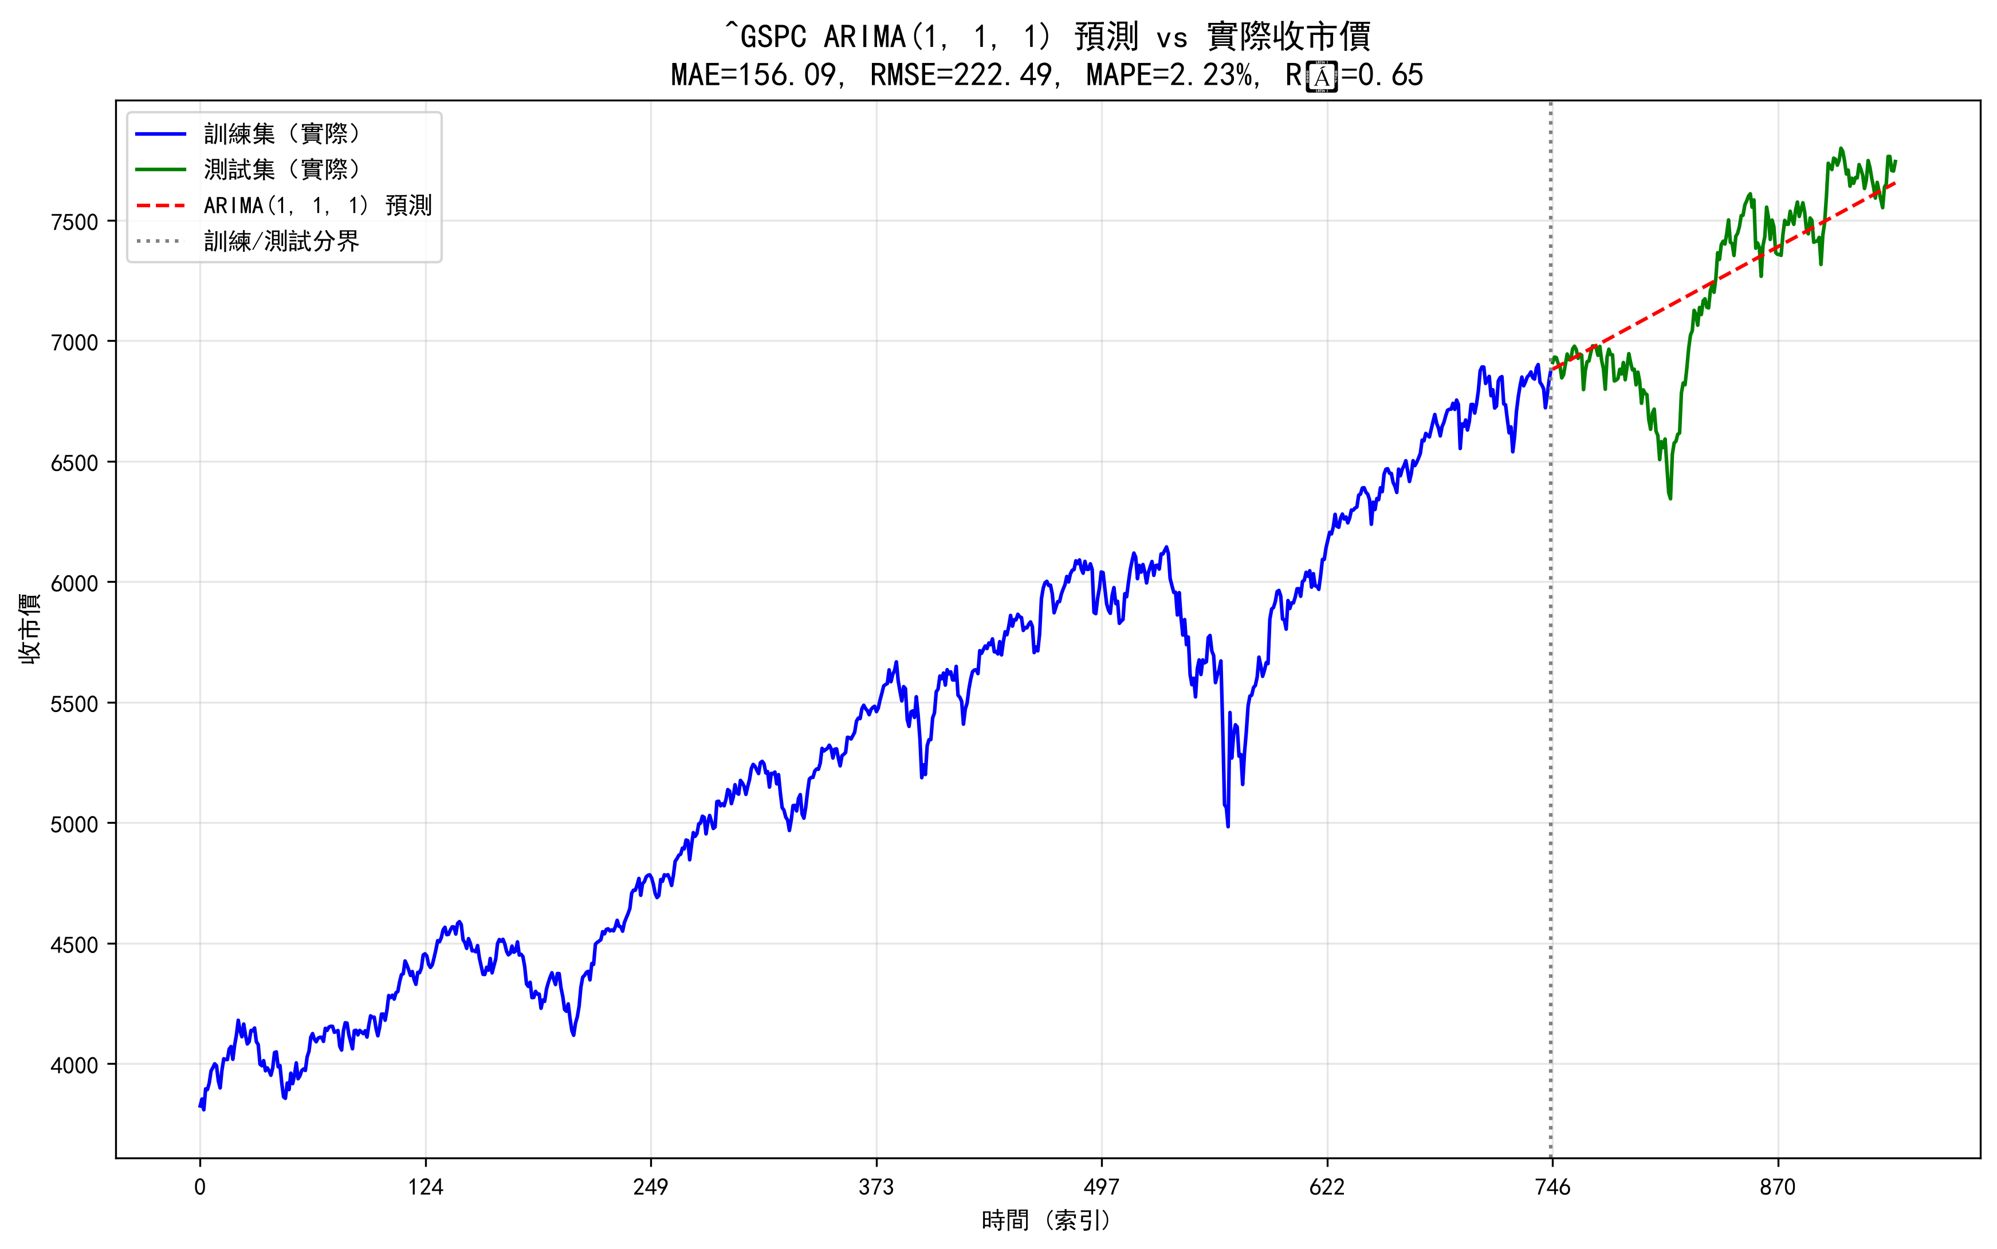
ARIMA (S&P500)
13 / 14
2023-01 2023-07 2024-01 2024-07 2025-01 2025-07 2026-01 2026-07 2026-09
CT298 · Python Data Analysis · 20 Oct 2026

Slide 17
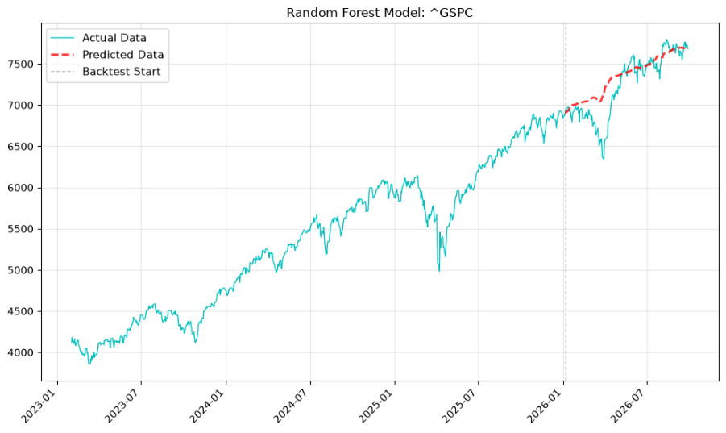
Random Forest (S&P500)
13 / 14
CT298 · Python Data Analysis · 20 Oct 2026

Slide 18
Linear Regression (HIS)
13 / 14
Extreme Data Removed (Daily Return > 2%) No. of Extreme Data Removed : 109
CT298 · Python Data Analysis · 20 Oct 2026

Slide 19

LSTM (0386.HK)
13 / 14
CT298 · Python Data Analysis · 20 Oct 2026

Slide 20
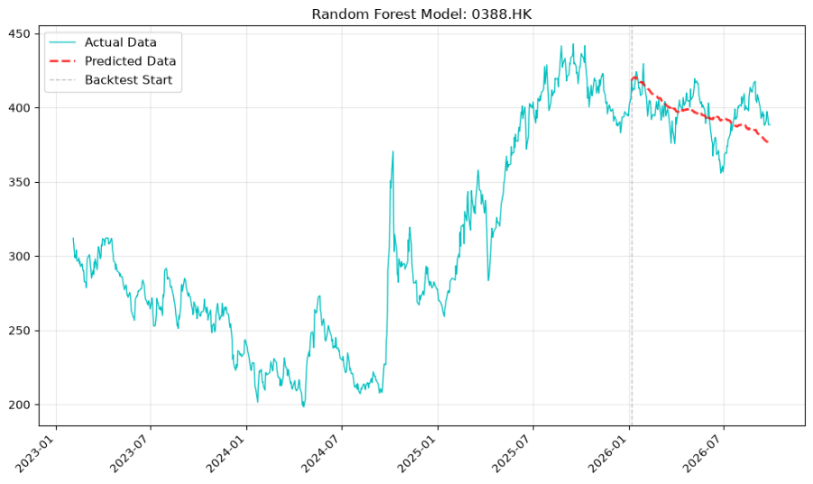
Random Forest (0388.HK)
13 / 14
CT298 · Python Data Analysis · 20 Oct 2026

Slide 21
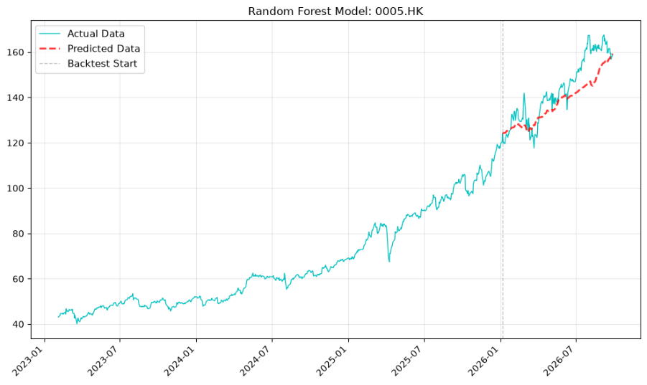
Random Forest (0005.HK)
13 / 14
CT298 · Python Data Analysis · 20 Oct 2026

